Slide 1







Neural Networks and MLP
Zach Schuster

Slide 2
What will we cover
The perceptron
Feed forward NNs
MLP
TensorFlow (code example)
Keras (code example)
TFLearn (contact author for detailed lessons)
MLP for time series regression
Keras (code example)

Slide 3
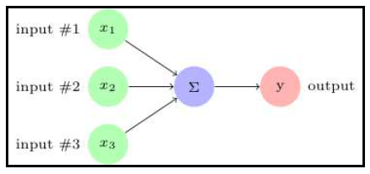
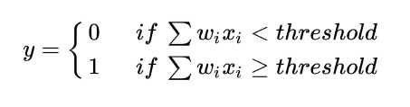
The perceptron
The summation is useless, right?
The threshold is known as the bias

Slide 4
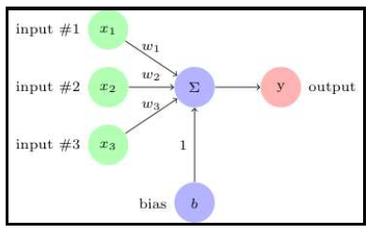
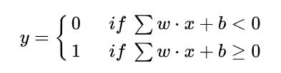
The perceptron
This is basically a linear regression as we have not added in any non-linear activation function

Slide 5
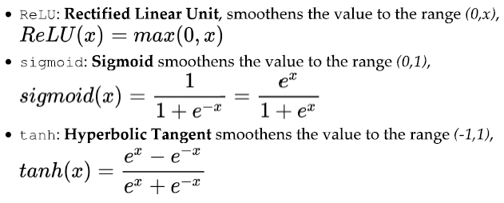
Activation Functions
This list is not comprehensive at all
An activation function can be applied to map the linear output of a given layer or node to a specific range of values.
Popular activation functions:
Inverse of logit function

Slide 6
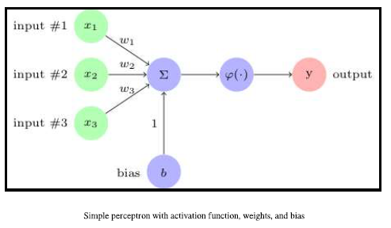

The perceptron
This now becomes a non-linear unit as long as activation is non-linear
This simple perceptron can be conceptualized as a neural network with one hidden layer and one “neuron” in that layer
Notes:
The activation function for output layer is usually softmax when predicting class probabilities.

Slide 7
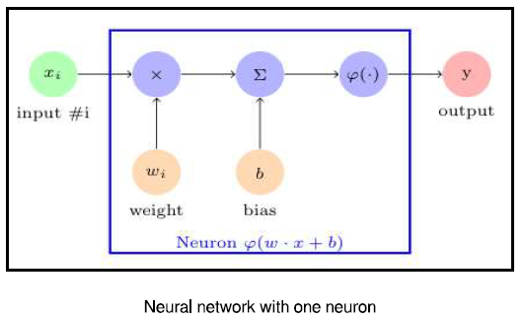
MultiLayer Perceptron
Note that this picture is called a “neural network with one neuron” and is identical to the picture from last slide (other than # of inputs).

Slide 8
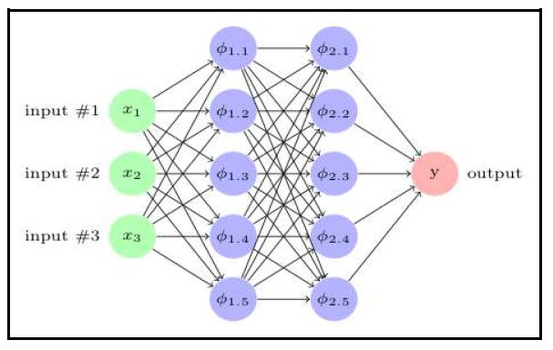
MultiLayer Perceptron
This is a FFNN (feed forward neural network) or a DNN (deep neural network)
Each layers output is input for the next layer
We can think of each node as its own regression (function) within a larger machine (which is a function of functions)

Slide 9
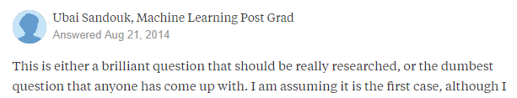
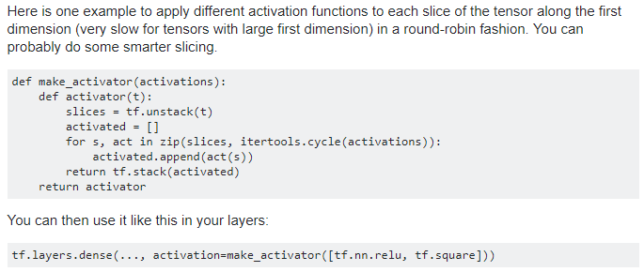
Random Thought on Activations
Could we or would we apply different activation functions within the same layer?

Slide 10
Discuss mlp function
Refer to jupyter notebook

Slide 11
Remember… Safety First!
(Enter your own creative tag line above)

